Slide 1
A survey of Constraint Handling Techniques in Evolutionary Computation Methods
Author:
Zbigneiw Michalewicz
Presenter:
Masoud Mazloom
27th Oct. 2010

Slide 2
Outline
Introduction
Numerical Optimization and Unfeasible solutions:
  Nonlinear programming problem
  Constraint-handling methods:
    The method of Homaifar, Lai & Qi
    The method of Joines & Houck
    The method of Michalewicz & Janikow
    The method of Michalewicz & Attia
    The method of Powell &skolnick
    The method of Schoenauer
    Death Penalty
    Repair method
Five test case
Experiments, Results

Slide 3
Introduction
Evaluation function:
one of the major components of any Evolutionary system.
Evolutionary computation techniques use efficient evaluation function for feasible individuals but these techniques have not developed any guidelines on how to deal with unfeasible solutions.
Evolutionary programming and evolution strategy:
(Back et al. 1991)
(Fogel and Stayton 1994)
Reject unfeasible individuals
Genetic Algorithms:
(Goldberg 1989)
Penalize unfeasible individuals
Is there any general rule for designing penalty functions?

Slide 4
10/27/10

Slide 5
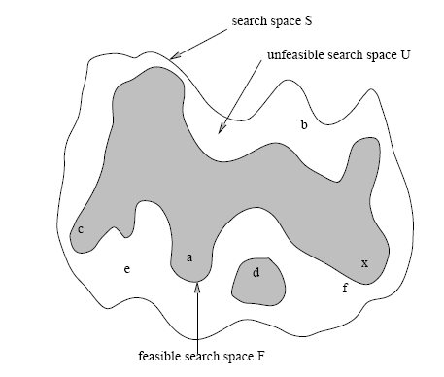
Introduction Continue
We don’t make any assumptions about about these subspace:
They need not be convex
They not be connected

Slide 6
Introduction Continue.
We have to deal with various feasible and unfeasible individuals.
A population may contain some feasible (a, c, d) and unfeasible individuals (b, e, f), while the optimum solution is ‘x’
Problem:
How to deal with unfeasible individuals?
In general we have to design two two evaluations functions:
1. eval f: for feasible domain
2. eval u: for unfeasible domain

Slide 7
Introduction Continue
1. How should two feasible individuals be compared?
2. How should two unfeasible individuals be compared?
3. Should we assume that
for any and fo and any
In particular, which individual is better: individual ‘c’ or unfeasible individual ‘f’ (note that the optimum is ‘x’)
4. Should we consider unfeasible individuals harmful and eliminate them from the population? ( may be there are useful)
5. Should we ‘repair’ unfeasible solutions by moving them into the closest point of the feasible space ? ( should we use a repair procedure for evaluation purpose only)
6. Should we chose to penalize unfeasible individuals?

Slide 8
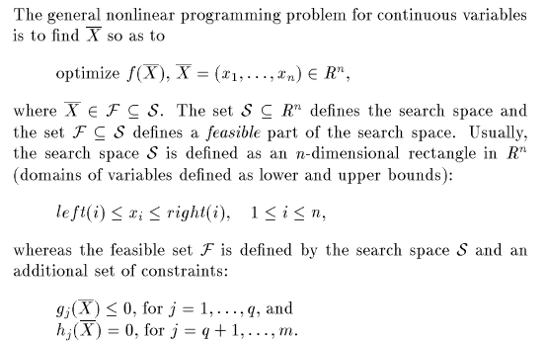
Numerical Optimization and Unfeasible solutions
Non linear programming problem:

Slide 9
10/27/10

Slide 10
Condtrain Handling methods
Methods based on preserving feasibility of solutions:
a) Use of specialized operations ( The method of Michalewicz & Janikow)
b) Searching the boundary of feasible region
2. Methods based on penalty functions:
a) Static penalty ( The method of Homaifar, Lai & Qi)
b) Dynamic Penalty ( The method of Joines & Houck)
c) Annealing penalty ( The method of Michalewicz & Attia)
d) Death Penalty ( The method of Michalewicz)
3. Methods based on a search for feasible soluitons:
a) Superiority of feasible points ( The method of Powell & Skolniks)
b) Behavioral memory method (The method of Schoenauer & Xanthakis)
4. Muti-Objective optimization methods:
a) the method of Paredis
b) Cultural Algorithms

Slide 11
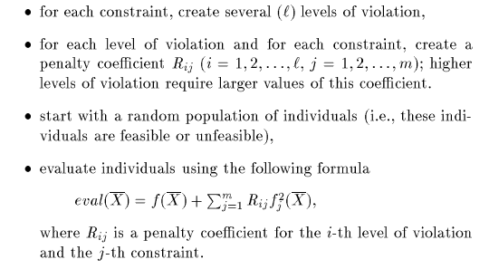
Static penalty ( The method of Homaifar, Lai & Qi)
For every constraint we establish a family of intervals that determine appropriate penalty value.
The methods works as follows:

Slide 12
Static penalty Continue
Weakness:
Number of parameters: m(2l+1)
m=5, l=4: 45 parameters
Quality of solutions heavily depends on the values of these parameters:
if Rij are moderate: algorithm converge to an unfeasible solution
if Rij are too large: algorithm reject unfeasible solution
Finding an optimal set of parameters for reaching to a feasible solution near optimum is quite difficult.

Slide 13
Dynamic Penalty ( The method of Joines & Houck)
In this method individuals are evaluated (at the iteration t) by the following formula:
C,α, β are constant.
The method is quite similar to Homaifar et al. but it require many fewer parameter .
This method is independent of the total number of constraints.
Penalty component changes with the generation number.
The pressure on unfeasible solutions is increased due to the:
Quality of the solution was very sensitive to values of these three parameters (reasonable parameters are

Slide 14
Annealing penalty ( The method of Michalewicz & Attia)
In this method linear and nonlinear constraints are processed separately.
The method works as follow:

Slide 15
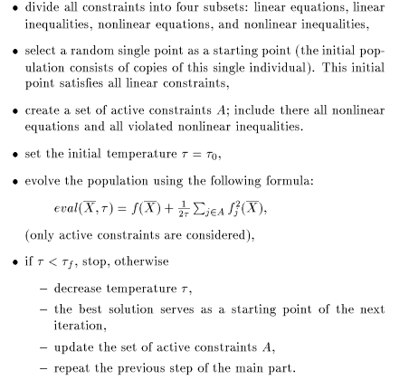

Slide 16
At every iteration the algorithm considers active constraints only.
The pressure on unfeasible solution is increased due to the decreasing values of temperature ζ.
This method is quite sensitive to values of its parameters:
starting temperature ζ, freezing temperature ζ0 and cooling scheme ζf to decrease temperature ζ ( standard value s are )
This algorithm may converge to a near-optimum solution just in one iteration

Slide 17
Death Penalty ( The method of Michalewicz
This method is popular option in many evolutionary techniques like evolutionary programming.
Removing unfeasible solutions from population may work well when the feasible search space F is convex and it constitutes a reasonable part of the whole search space.
For some problems where the ratio between the size of F and S is small and an initial population consist of unfeasible individuals only, we must to improve them.
Experiment shows that when ratio between F and S was between 0% and 0.5% this method performed worse than other methods.
Unfeasible solutions should provide information and not just be thrown away

Slide 18
Methods based on preserving feasibility of solutions: Use of specialized operators
( The method of Michalewicz & Janikow)
The idea behind this method is based on specialized operators which transform feasible individuala into feasible individuals.
This method works only with linear constraint and a feasible starting point .
A close set of operators maintains feasibility of solutions ( the offspring solution vector is always feasible).
Mutation ( which values xi will give from its domain?)
Crossover:
It gave surprisingly good performance on many test functions.
Weakness of the method lies in its inability to deal with non convex search space ( to deal with nonlinear constraints in general)

Slide 19
Methods based on a search for feasible solutions: Superiority of feasible points
(The method of Powell & Skolniks)
The key concept behind this method is the assumption of superiority of feasible solutions over unfeasible ones.
Incorporate a heuristic rule for processing unfeasible solutions:
“ every feasible solution is better than every unfeasible solution”
This rule is implemented in the following way:
evaluations of feasible solutions are mapped into the interval (-∞,1)
evaluations of unfeasible solutions are mapped into the interval (1, ∞)

Slide 20
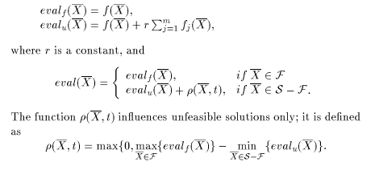

Evaluation procedure:

Slide 21
Experiments show that this method work very well however the topology of the feasible search space might be an important factor.
For problems with a small ratio |F|/|S| the algorithm is often trapped into an unfeasible solution.
This method should require at least one feasible individual for start.

Slide 22
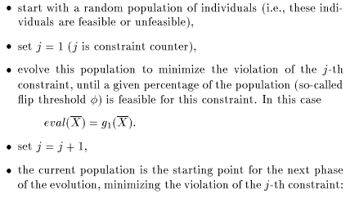
Behavioral memory method
(The method of Schoenauer & Xanthakis)
This method based on the idea of handling constraints in a particular order.

Slide 23
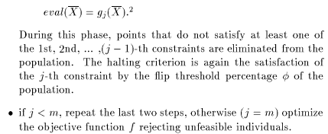
This method require 3 parameter:
sharing factor (to maintain diversity of the population)
flip threshold
particular permutation of constraint which determine their order

Slide 24
In the final step of this algorithm the objective function f is optimized.
But for large feasible spaces the method just provides additional computational overhead.
For very small feasible search space it is essential to maintain a diversity in the population
Experiments indicate that the method provides a reasonable performance except when the feasible search “too small”

Slide 25
10/27/10

Slide 26

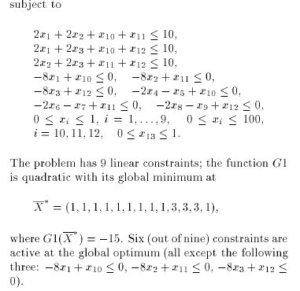
Test case #1

Slide 27
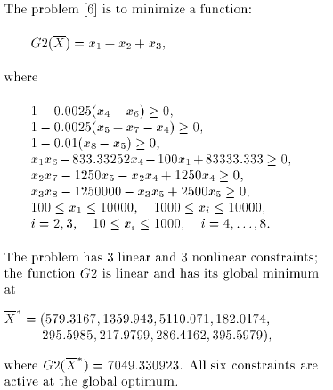
Test case #2

Slide 28

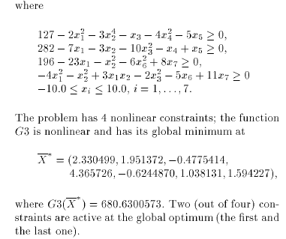
Test case #3

Slide 29
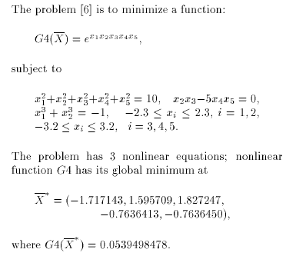
Test case #4

Slide 30
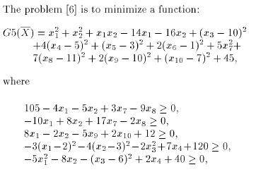
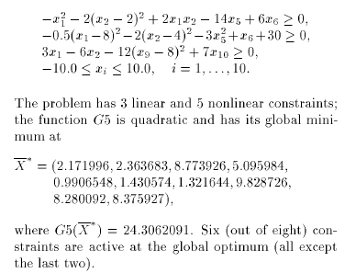
Test Case #5

Slide 31
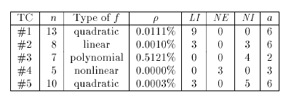
Summary of test case

Slide 32
In the table below :
Method #1 is: Homaifar’s method
Method #2 is: joines ‘s method
Method #3 is: Xanthakis’s mehtod
Method #4 is: Attia’ s method
Method #5 is: powell’s method
Method #6 is: Death penalty

Slide 33
10/27/10

Slide 34
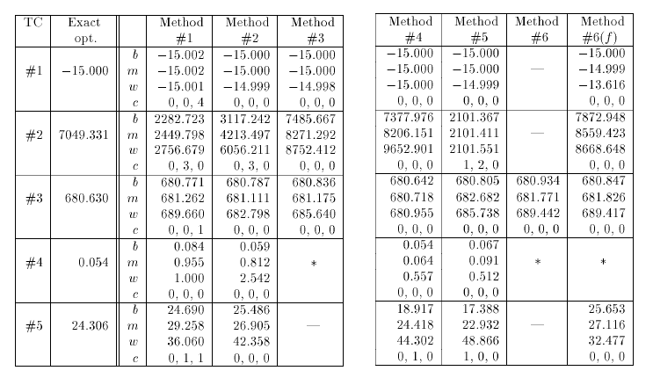
Experimental, Result

Slide 35
Questions?

